Slide 1
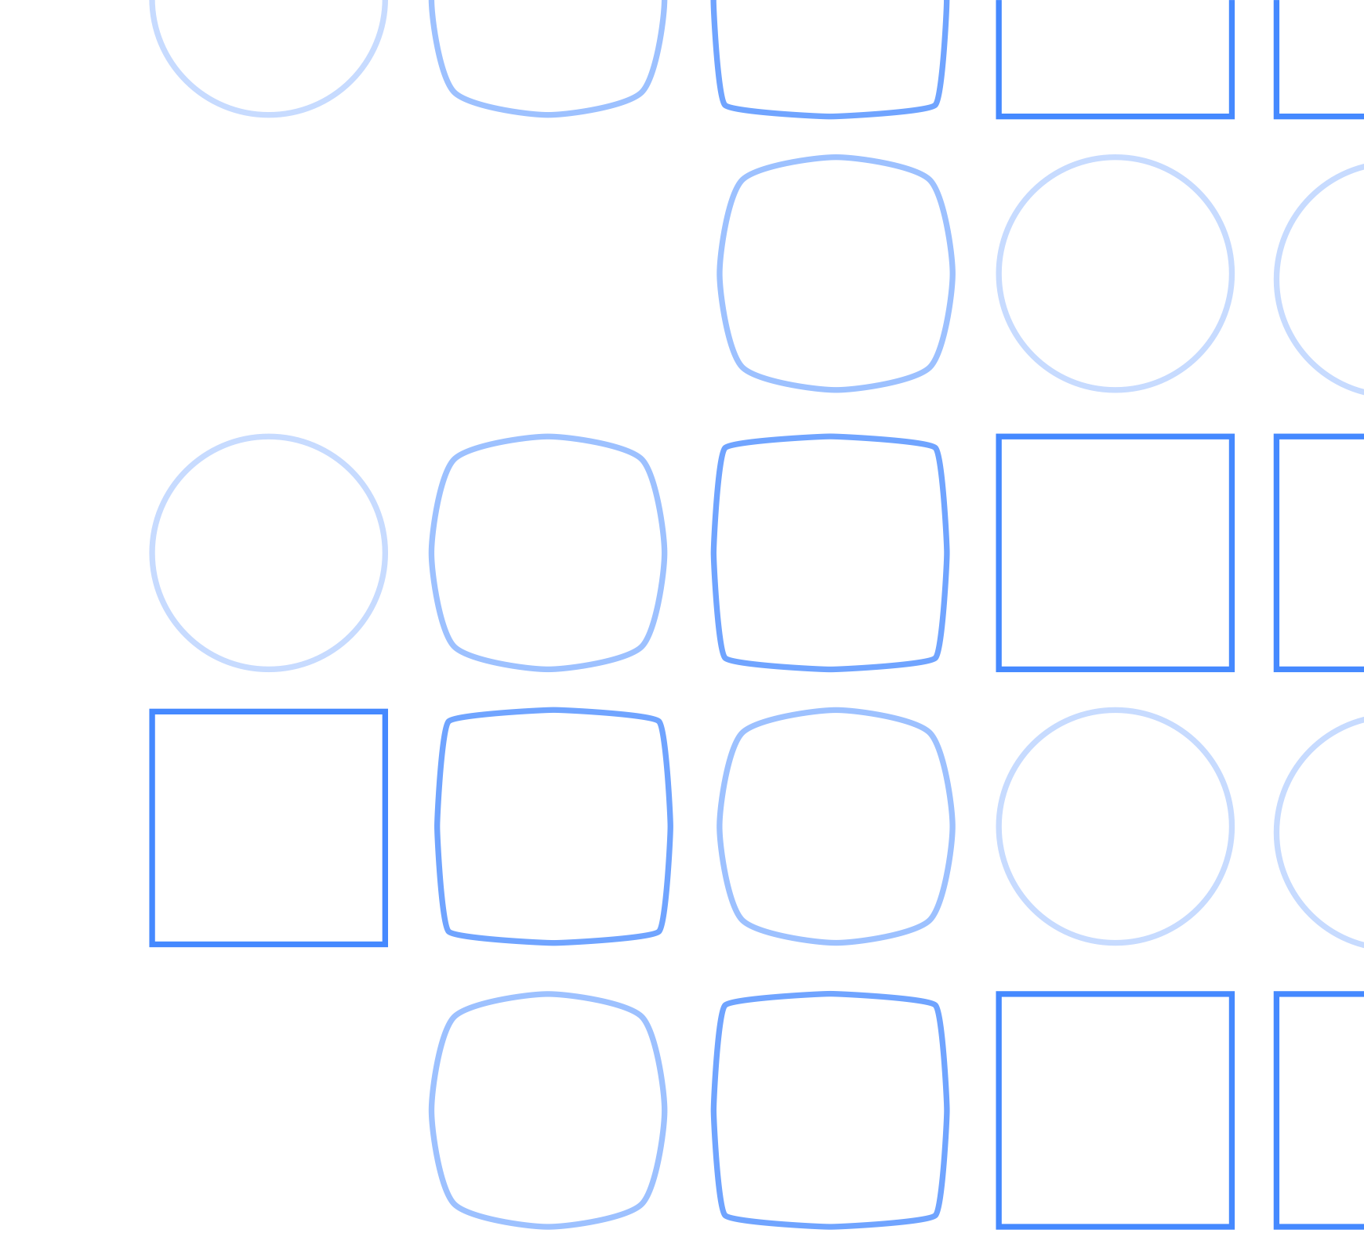
Exploring the electronic structure of a molecule with Qiskit speaker: Mario Motta IBM Almaden Research Center

Slide 2
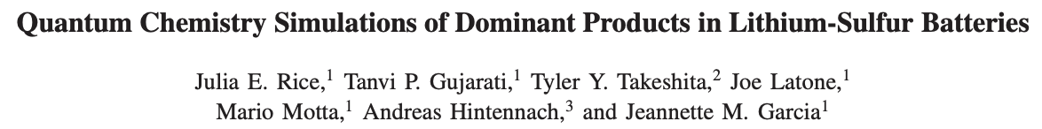
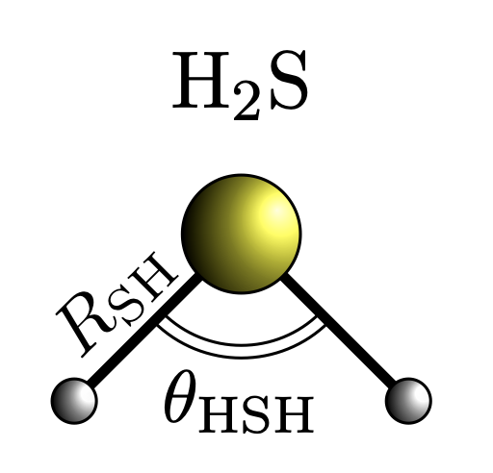
An example from related to recent work
Computation of dipole moments within variational quantum algorithms
https://github.com/mariomotta/qiskit_exercise
https://arxiv.org/pdf/2001.01120

Slide 3
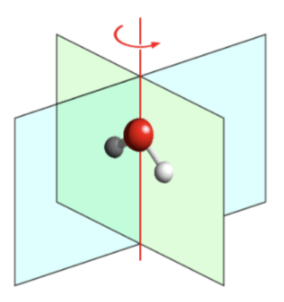
Step 1: identify geometry, basis, symmetry group
Useful resource for reference/experimental geometries: https://cccbdb.nist.gov
The chosen/optimized molecular geometry dictates the molecular point group symmetry
Knowledge of the symmetry group is important for mean-field and correlated calculations
H₂S has C₂ symmetry around the red axis
and two vertical (containing the axis) mirror planes,
hence the symmetry group is C_{2v}
The C_{2v} symmetry group has 4 irreducible representations,
A₁: eigenfunction of C₂, σ_{v} with eigenvalues 1,1
A₂: eigenfunction of C₂, σ_{v} with eigenvalues 1,-1
B₁: eigenfunction of C₂, σ_{v} with eigenvalues -1,1
B₂: eigenfunction of C₂, σ_{v} with eigenvalues -1,-1
S

Slide 4
Step 1: identify geometry, basis, symmetry group
In chemistry, many basis sets comprising atom-centered Gaussian orbitals are available, e.g.
STO-nG: minimal bases, only containing valence orbitals (very outdated, but also very small)
X-YZG: split-valence bases (designed for converging mean-field calculations)
cc-pVxZ: correlation-consistent bases (designed for converging correlated calculations)
X-YZG*(**): split-valence bases with polarized orbitals on heavy atoms (all atoms)
X-YZ+(++)G: split-valence bases with diffused orbitals on heavy atoms (all atoms)
aug-cc-pVxZ: correlation-consistent bases with diffuse orbitals
Accurate calculations require large (expensive) bases with
high-angular-momentum, polarized (diffused) orbitals.
Here, we will use a minimal STO-6G basis (11 orbitals)
H₁: 1s
H₂: 1s
S: 1s, 2s, 2px, 2py, 2pz, 3s, 3px, 3py, 3pz
S

Slide 5
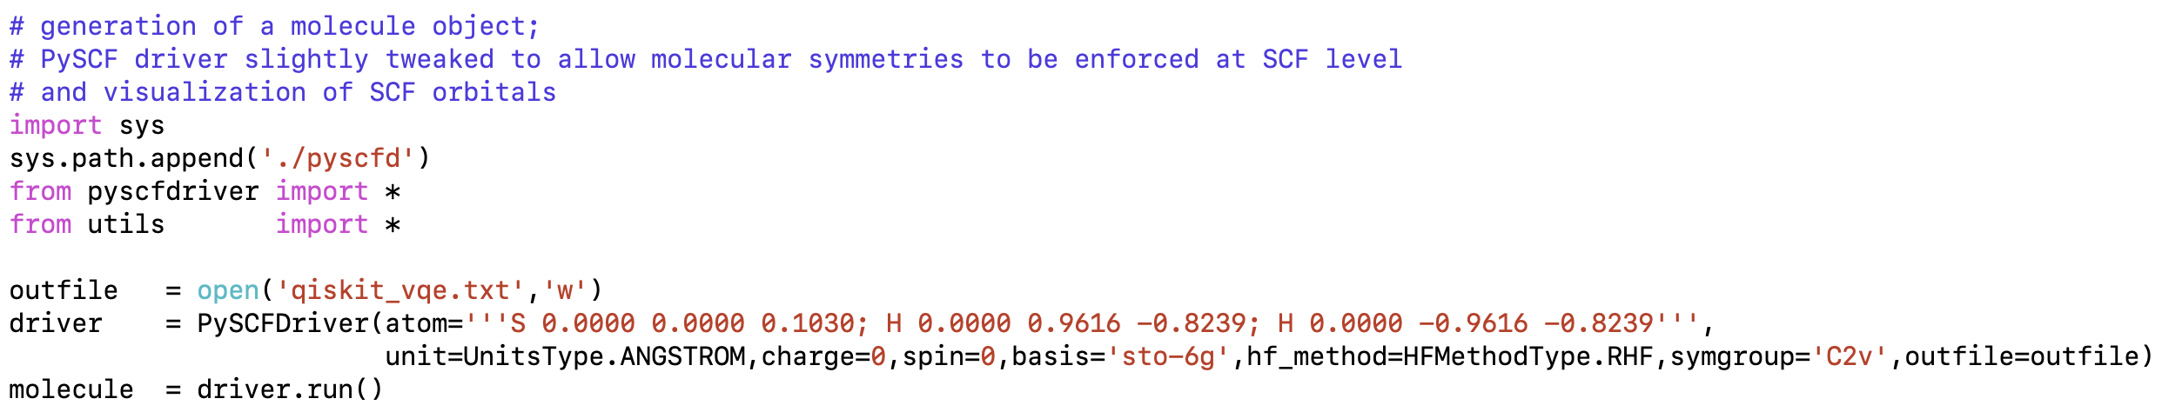
Step 2: setting up a qmolecule object
geometry
symmetry
driver.run() generates a molecular object from a mean-field (in this case restricted Hartree-Fock) calculation
https://qiskit.org/documentation/stubs/qiskit.chemistry.QMolecule.html
Here, the mean-field calculation is carried out with the PySCF software
https://github.com/pyscf/pyscf
https://onlinelibrary.wiley.com/doi/abs/10.1002/wcms.1340
https://aip.scitation.org/doi/10.1063/5.0006074
PySCF driver slightly extended (see pyscfd/integrals.py) Let us take a look at the SCF orbitals…

Slide 6
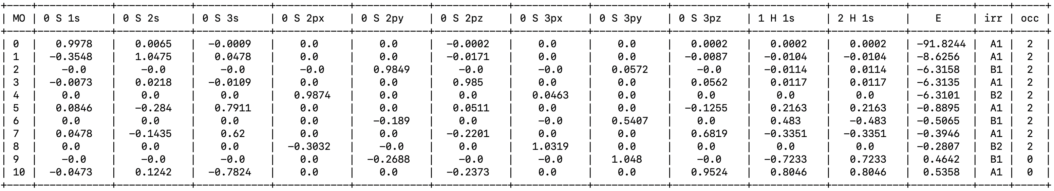
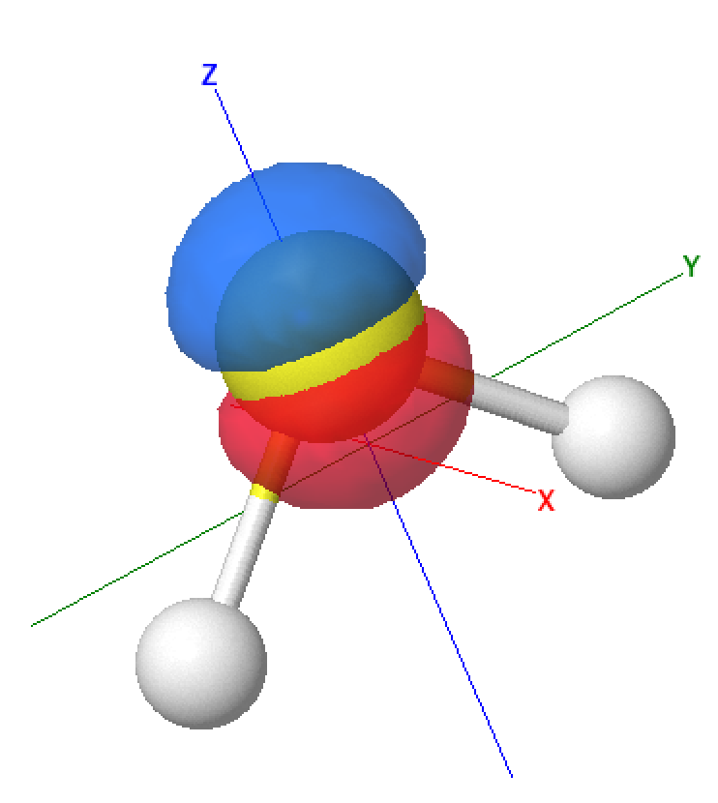
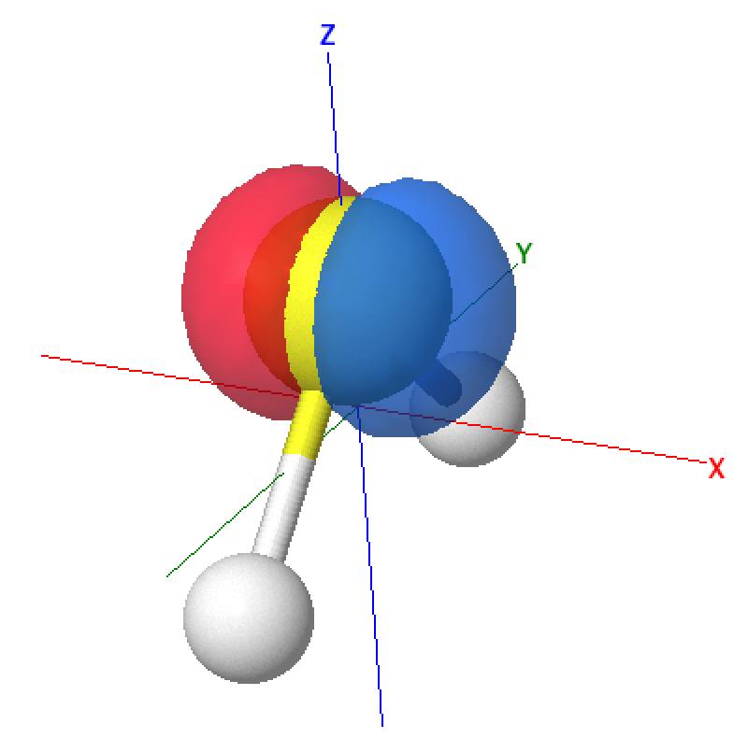
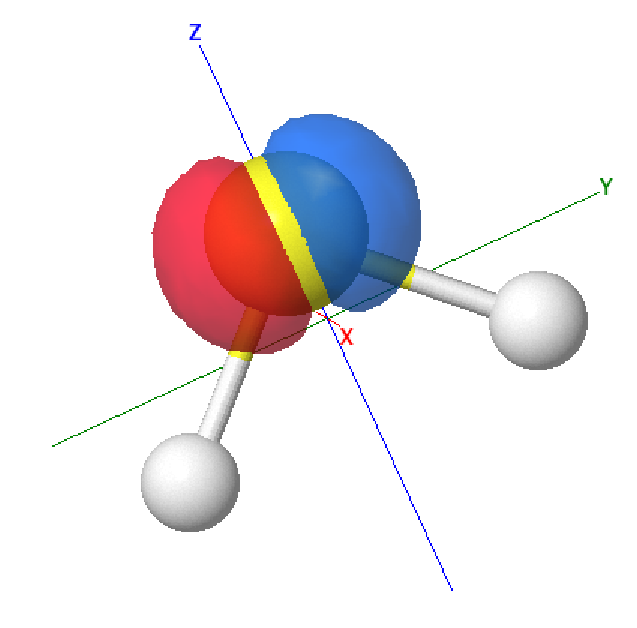
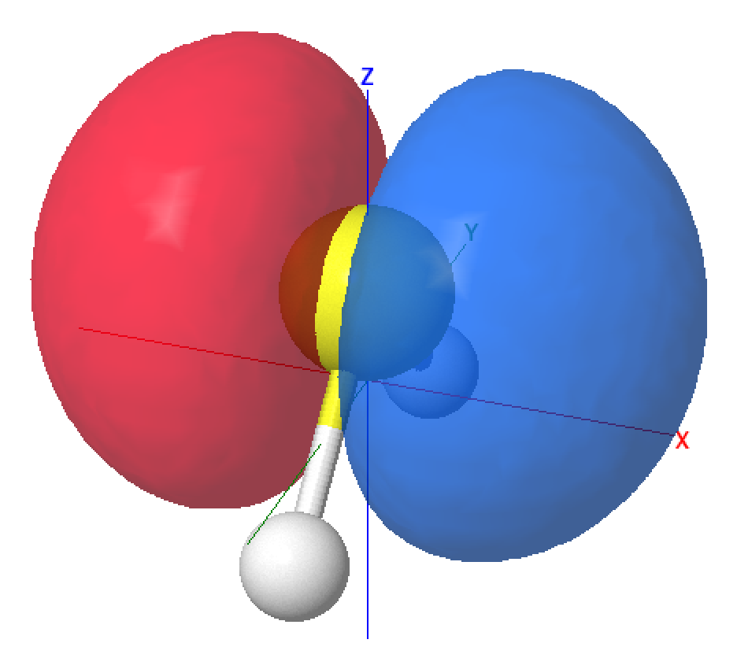
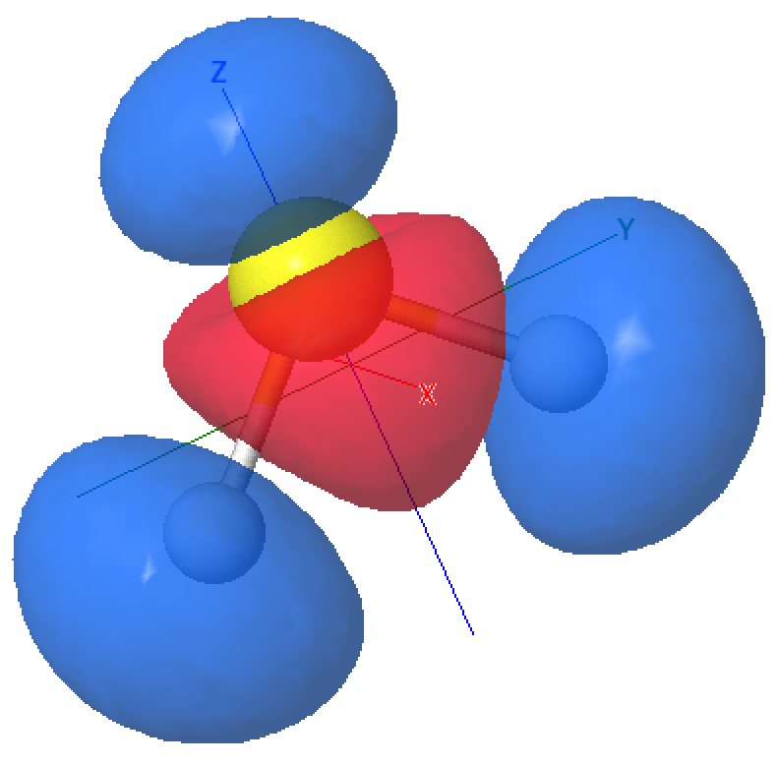
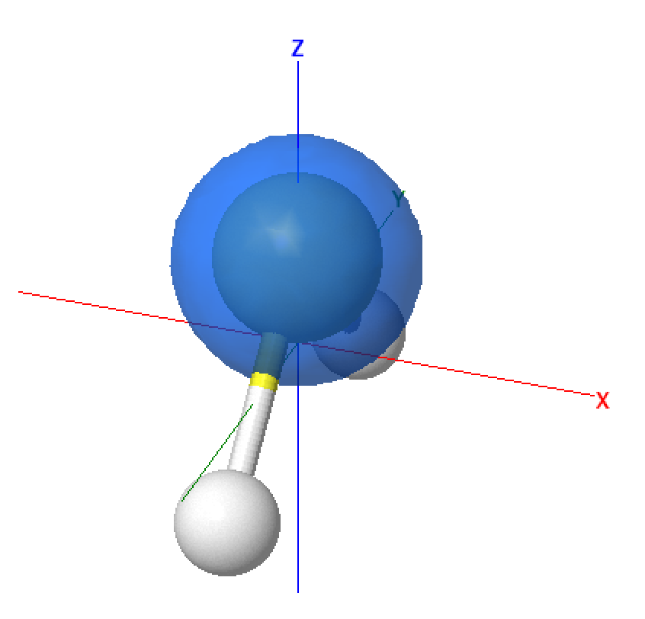
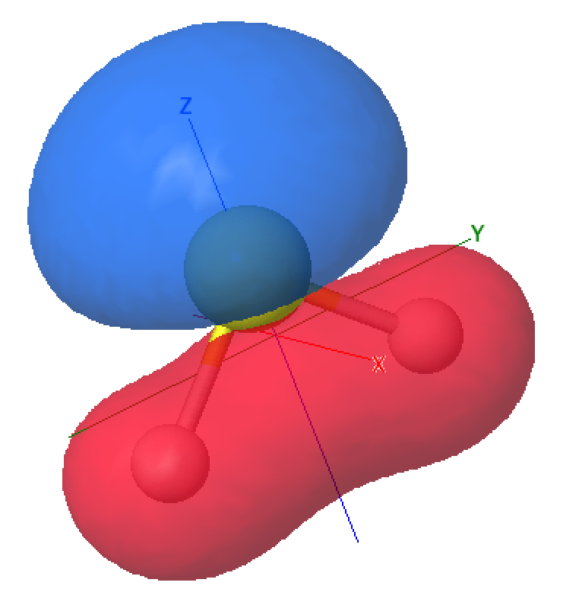
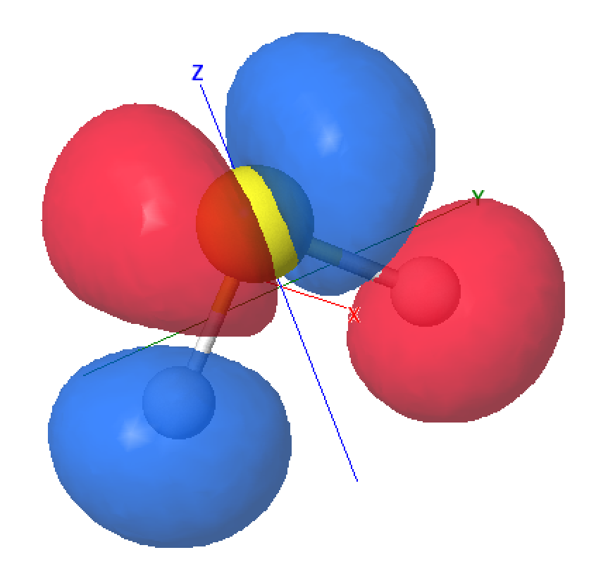
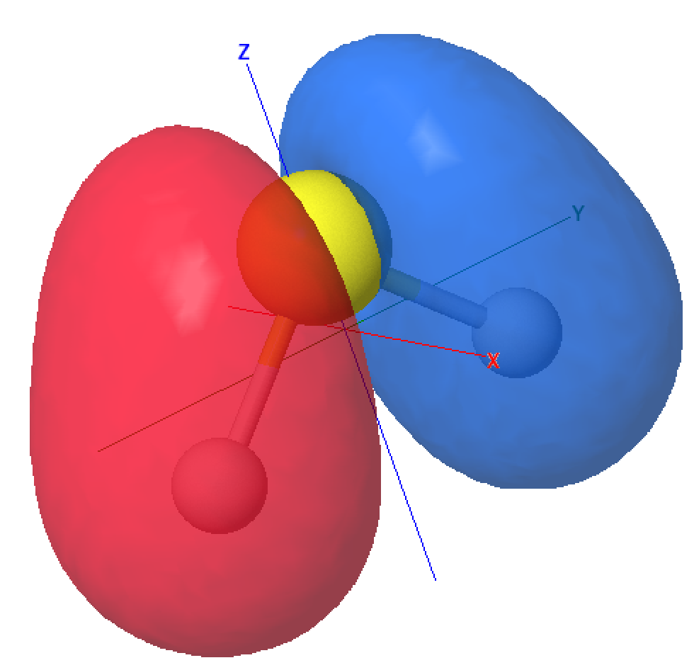
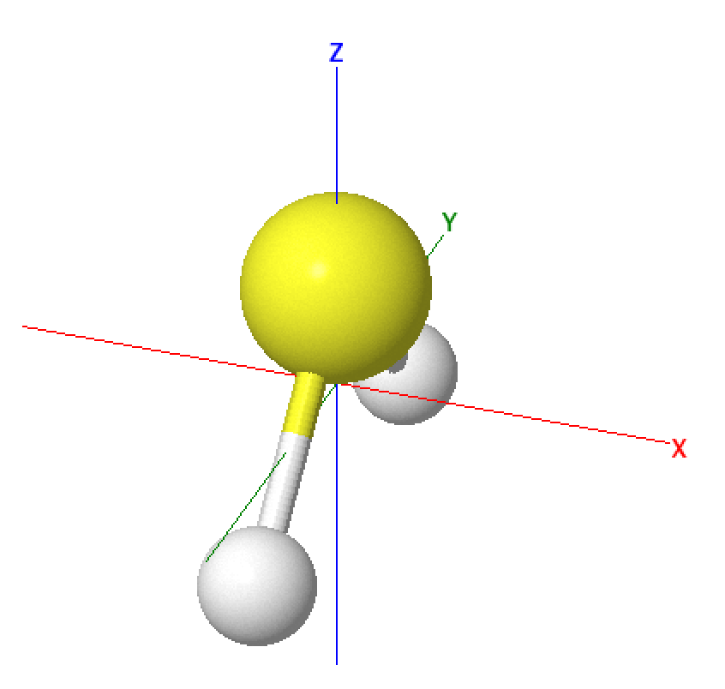
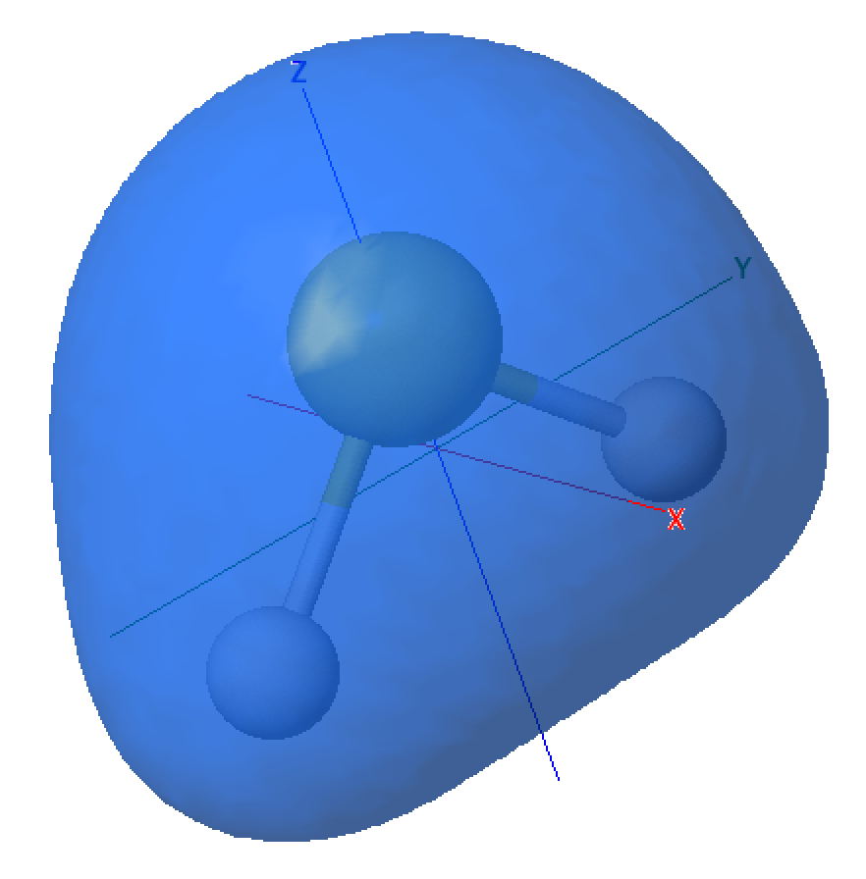
Step 2: setting up a qmolecule object
Core
Occupied
Virtual
2 3 4
8
10
1
7
9
6
0
5
table in qiskit_vqe.txt file
mos-*.spt files contain the molecular orbitals, in a format that
jmol can read and plot http://jmol.sourceforge.net

Slide 7
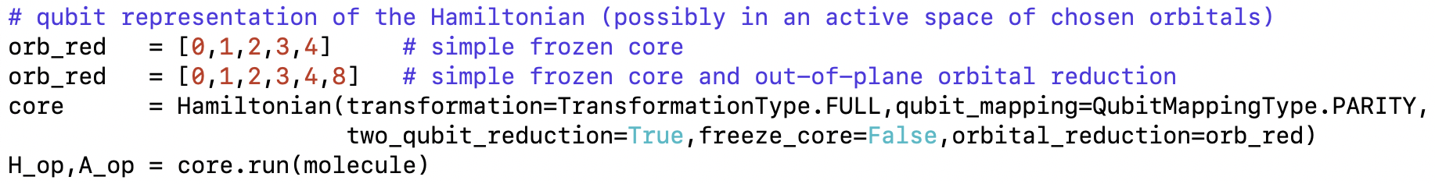
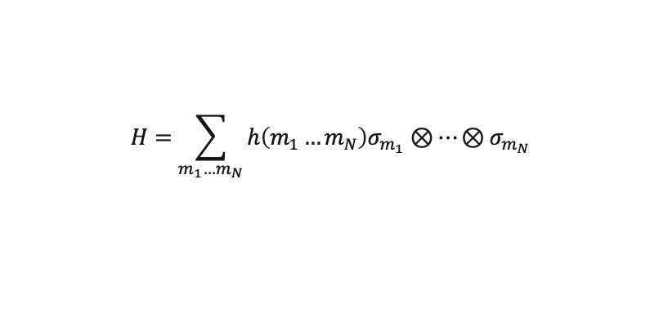
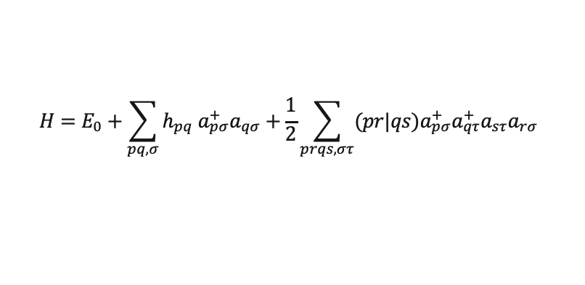
Step 3: the Hamiltonian and its qubit representation
encoding
Molecular orbitals
Selected for quantum
simulation
https://qiskit.org/documentation/stubs/qiskit.chemistry.core.Hamiltonian.html
generate the electronic structure Hamiltonian and map it onto the Hamiltonian of N qubits
this paper is an excellent review of encoding strategies (Jordan-Wigner, Parity, Bravyi-Kitaev…)
$$H=E_{0}+\sum_{pq,σ}{h_{pq} a_{pσ}^{+}a_{qσ}^{}+\frac{1}{2}\sum_{prqs,στ}{(pr|qs)a_{pσ}^{+}a_{qτ}^{+}a_{sτ}^{}a_{rσ}^{}} }$$
$$H=\sum_{m_{1}…m_{N}}{h\left(m_{1}…m_{N}\right)σ_{m_{1}}⊗…⊗σ_{m_{N}}}$$
https://dx.doi.org/10.1063/1.4768229

Slide 8
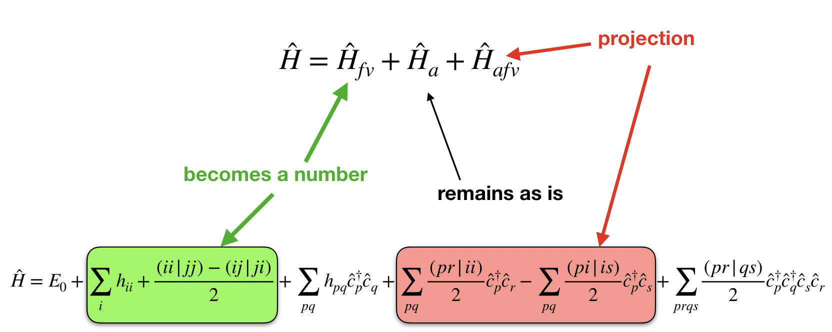
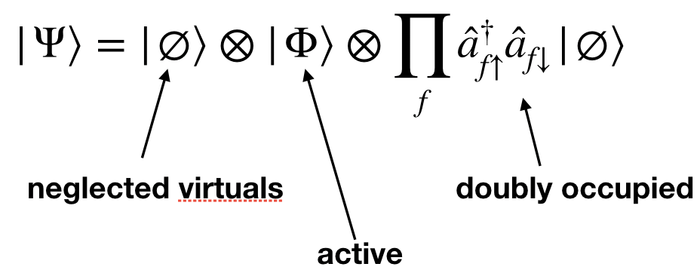
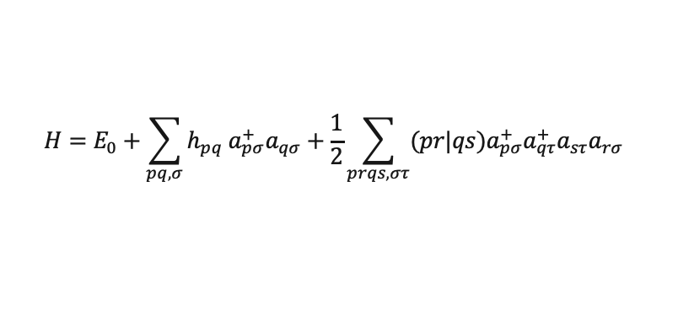
Step 3: the Hamiltonian and its qubit representation
For chemical/technical reasons, we may want to include only certain occupied/virtual orbitals in the Hamiltonian
This procedure is an example of the construction of an “active space”.
Virtuals deemed inactive (because electrons tend not to transition to these orbitals) can be removed from the summation.
Occupied orbitals deemed inactive (because electrons tend not to transition from these orbitals) need to be frozen.
$$H=E_{0}+\sum_{pq,σ}{h_{pq} a_{pσ}^{+}a_{qσ}^{}+\frac{1}{2}\sum_{prqs,στ}{(pr|qs)a_{pσ}^{+}a_{qτ}^{+}a_{sτ}^{}a_{rσ}^{}} }$$
https://dx.doi.org/10.1063/1.4768229

Slide 9
Step 3: the Hamiltonian and its qubit representation
Core
Occupied
Virtual
2 3 4
8
10
1
7
9
6
0
5

Slide 10
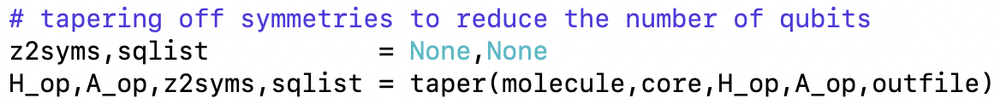
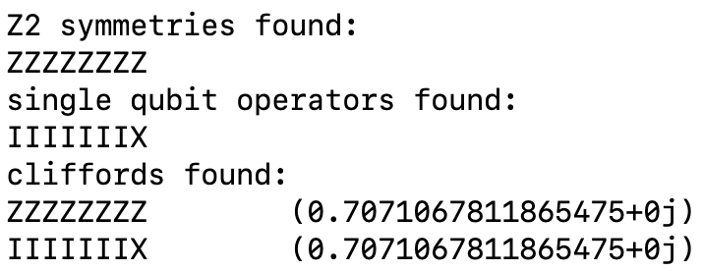
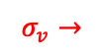
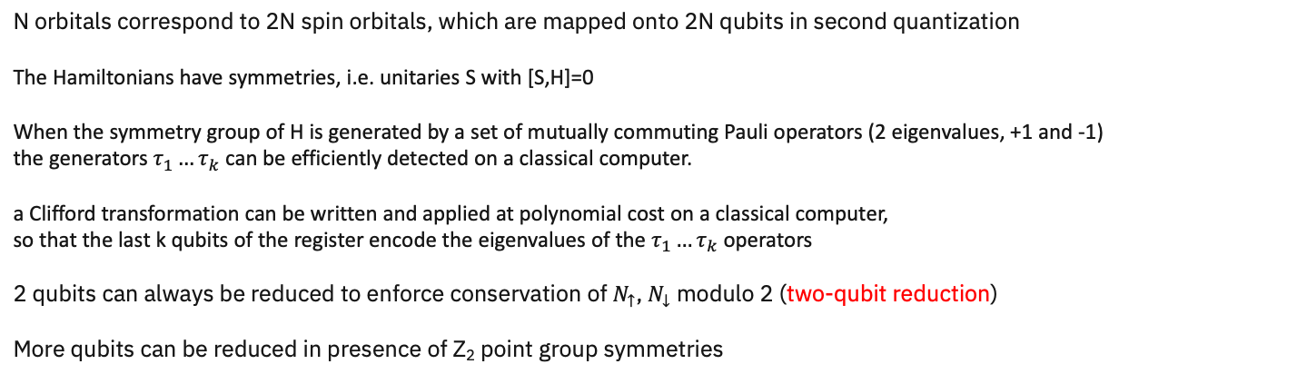
Step 4: leveraging symmetries to reduce qubit number
N orbitals correspond to 2N spin orbitals, which are mapped onto 2N qubits in second quantization
The Hamiltonians have symmetries, i.e. unitaries S with [S,H]=0
When the symmetry group of H is generated by a set of mutually commuting Pauli operators (2 eigenvalues, +1 and -1)
the generators $τ_{1}…τ_{k}$ can be efficiently detected on a classical computer.
a Clifford transformation can be written and applied at polynomial cost on a classical computer,
so that the last k qubits of the register encode the eigenvalues of the $τ_{1}…τ_{k}$ operators
2 qubits can always be reduced to enforce conservation of $N_{↑}$, $N_{↓}$ modulo 2 (two-qubit reduction)
More qubits can be reduced in presence of Z₂ point group symmetries
$$σ_{v}→$$
https://arxiv.org/abs/1701.08213
https://arxiv.org/abs/1910.14644

Slide 11
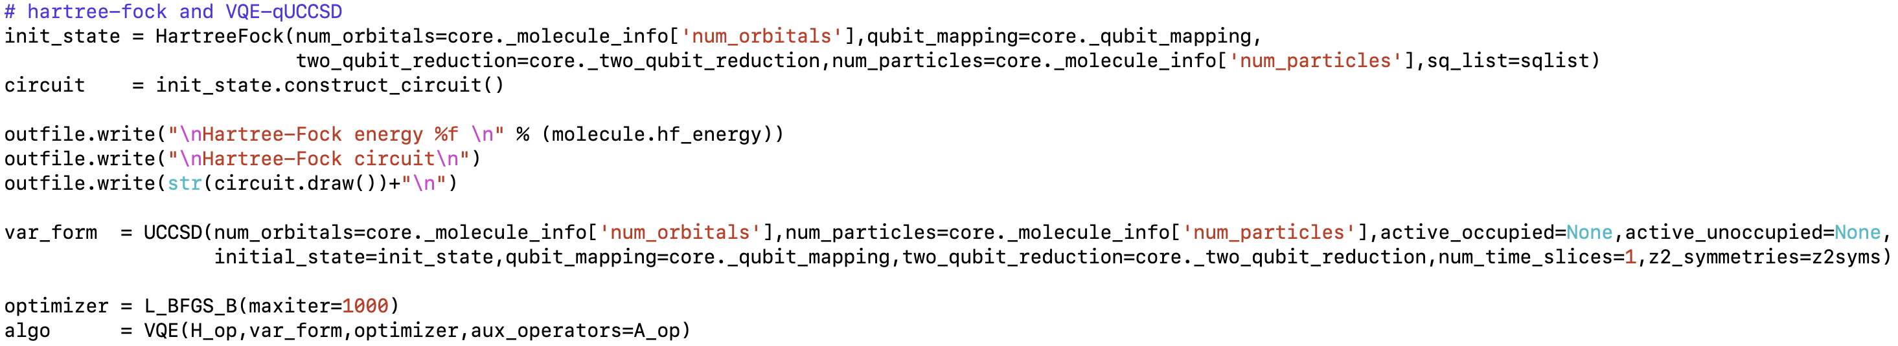
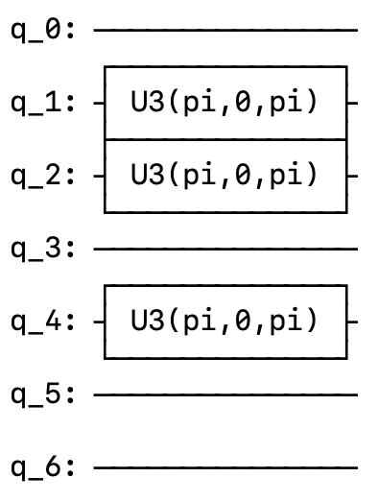
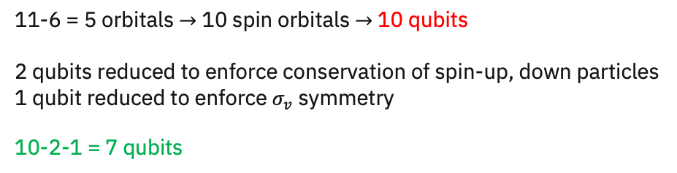
Step 5: exploring the electronic structure
11-6 = 5 orbitals $→$ 10 spin orbitals $→$ 10 qubits
2 qubits reduced to enforce conservation of spin-up, down particles
1 qubit reduced to enforce $σ_{v}$ symmetry
10-2-1 = 7 qubits

Slide 12
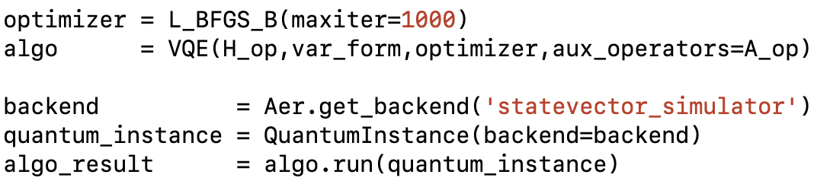
Step 5: exploring the electronic structure
In a VQE simulation, the energy is minimized as a function of the circuit parameters.
Of course, this requires an optimizer.
On the classical “statevector” simulator (no statistical uncertainties), possible choices are:
COBYLA (constrained optimization by linear approximation)
CG (conjugate gradient)
SLSQP (sequential least squares)
BFGS (Broyden-Fletcher-Goldfarb-Shanno)
GC, SLSQP,BFGS are gradient-based optimizers, with gradient estimated numerically.
On the classical “qasm” simulator and on hardware (statistical uncertainties), the recommended choice is
SPSA (simultaneous perturbation stochastic approximation)

Slide 13
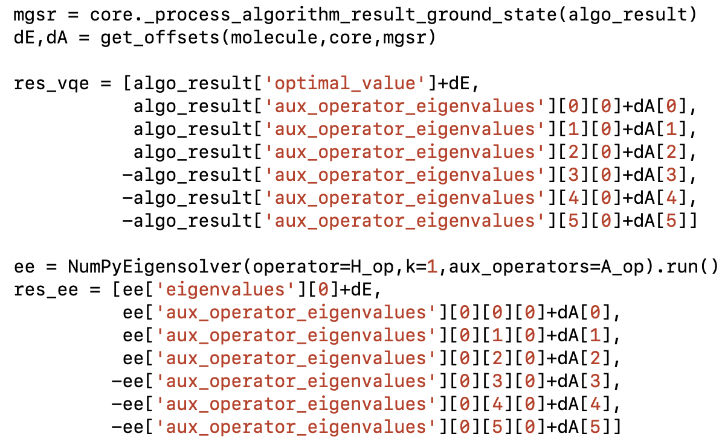
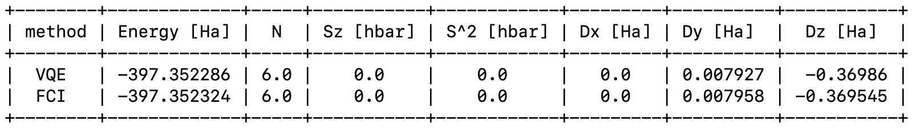
Step 6: harvesting results
Energy is important, but other properties too!
It is especially important to extract electrostatic properties (e.g. dipole moments)
but also information on particle number and spin, which can signal false convergence of VQE
broken C_{2v} symmetry (only 1 symmetry detected)

Slide 14
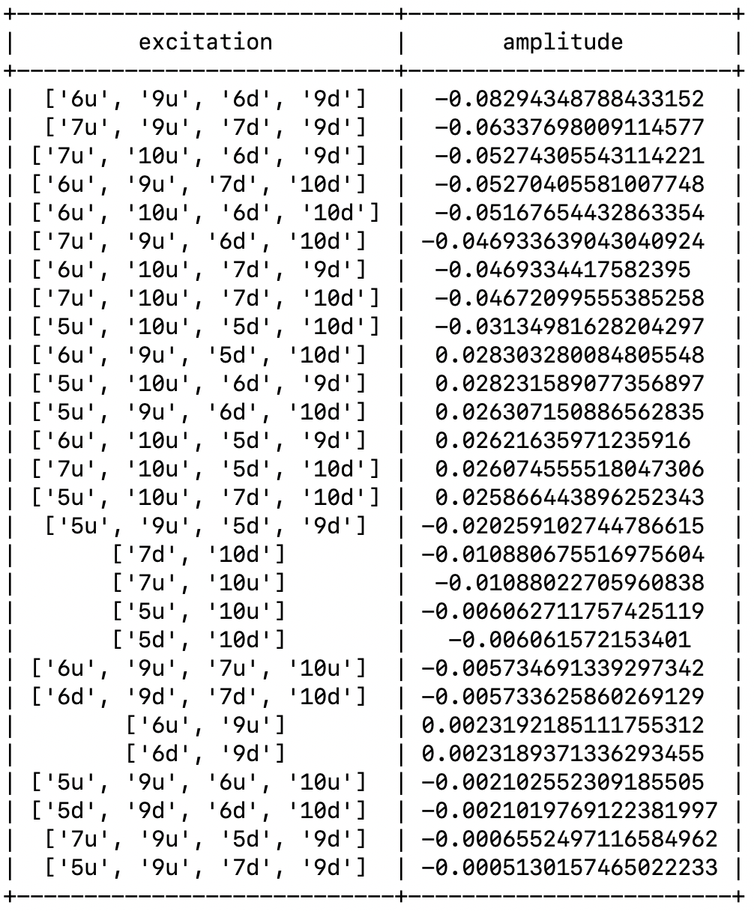
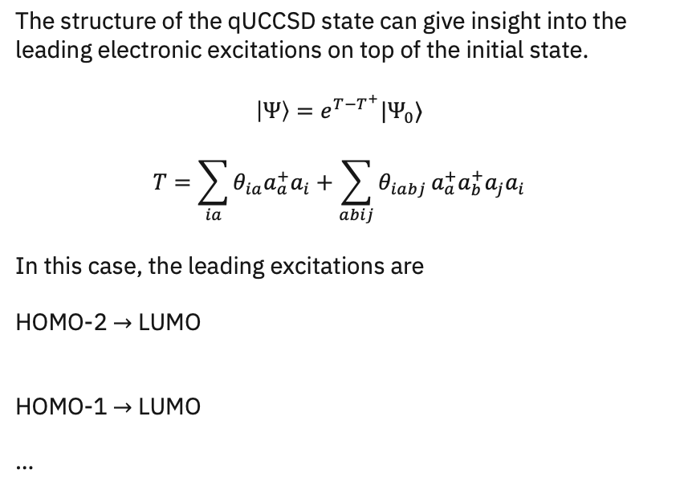
Step 6: exploring the electronic structure
The structure of the qUCCSD state can give insight into the
leading electronic excitations on top of the initial state.
$$\left|Ψ\right\rangle =e^{T−T^{+}}|Ψ_{0}⟩$$
$$T=\sum_{ia}{θ_{ia}a_{a}^{+}a_{i}}+\sum_{abij}{θ_{iabj}}a_{a}^{+}a_{b}^{+}a_{j}a_{i}$$
In this case, the leading excitations are
HOMO-2 $→$ LUMO
HOMO-1 $→$ LUMO
…

Slide 15
Step 6: comparing against exact diagonalization
NumpyEigensolver allows to
diagonalize the Hamiltonian (H_op), get k eigenvalues,
and evaluate expectation values of ancillary operators
(A_op) on the Hamiltonian eigenvectors
Order of ancillary operators:
number, spin-z, spin square, dipole-x, dipole-y, dipole-z

Slide 16
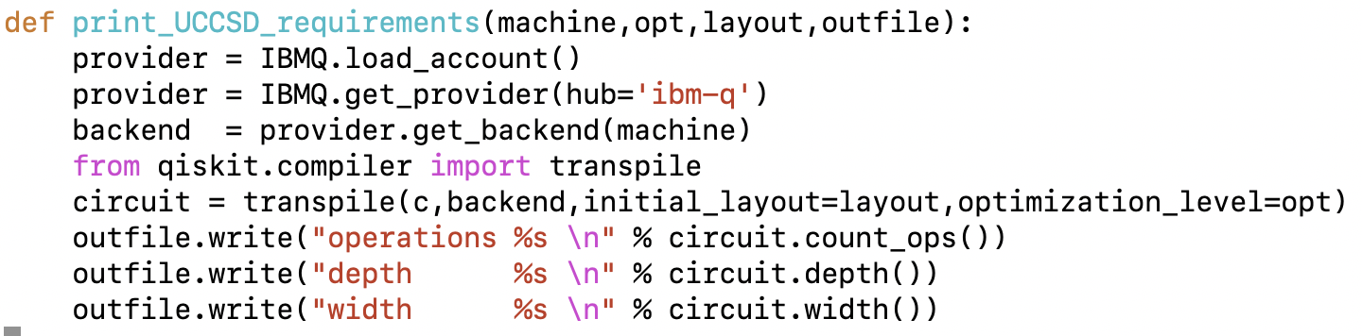
Step 6: circuit requirements
In order to design hardware experiments, it is important to know the features of the circuit to simulate.
These features include qubits number, gates and depth.
Gates and depth are influenced by the specific hardware chosen.

Slide 17
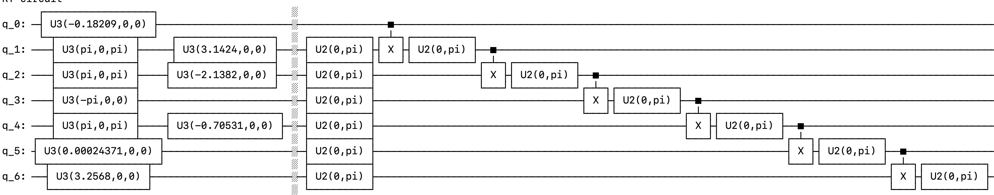
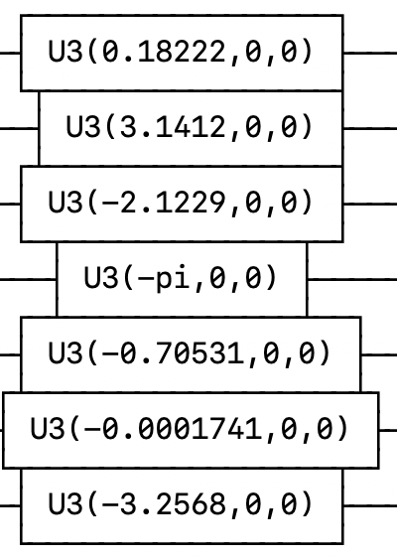
Hardware-efficient Ansatze
Circuits can be customized to capture features of the ground-state wavefunction
Hardware-efficient Ansatze are examples of circuits with
https://www.nature.com/articles/nature23879

Slide 18
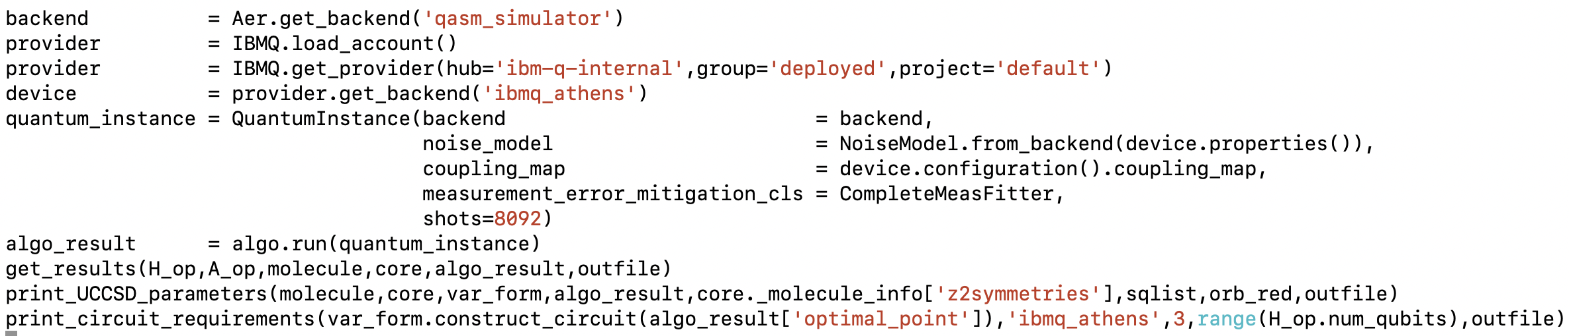
The “qasm” simulator
The “statevector” simulator performs linear algebra operations
The “qasm” simulator computes exact quantum-mechanical probability distributions
and samples probability distribution a user-defined number of times (shots)
qasm offers the possibility of simulating noise phenomena occurring on real hardware through noise models
and to experiment with techniques for readout error mitigation

